Slide 1
1
iCharitAble Group
Presenters: All Members

Slide 2
1
Group Members
Lerato Tlhako 220035380
Oratile Matlhabe 218015355
Cebani Nxumalo 220091240
Evan King 21905588
Zwakele Magagula 219059001
Kgotso Mathibela 220096987

Slide 3
Presentation Outline
Introduction and Brief Perspective of iCharitAble
Problem statement
Problem Objective
Proposed Solution
Solution Design / Architecture
Technologies used

Slide 4
Problem Statement
According to a recent article written by Elsa Oliveira and Rebecca Walker, we have noticed a huge poverty problem where people are not able to provide for themselves the basic needs that all people have the right to have, like food, water, electricity and shelter to protect themselves from disasters. A lot of people in these situations have been known to resort to criminal activities to try and support themselves in this regard but it usually leads to more harm than good.

Slide 5
Project Objective
To provide the donators an easier way to donate to the poor.
To provide an effective communication between donators.
To help the government notice the fake charities that promote human trafficking.
To reduce the crime rate of these people in need.

Slide 6
Proposed Solution
Due to the problem mentioned above, we have decided to create a donation web application which will allow South Africans who are privileged enough to have their needs supplemented, to give to those less fortunate. We want to alleviate the burdens that our people are carrying, however small, with this initiative we are taking.

Slide 7
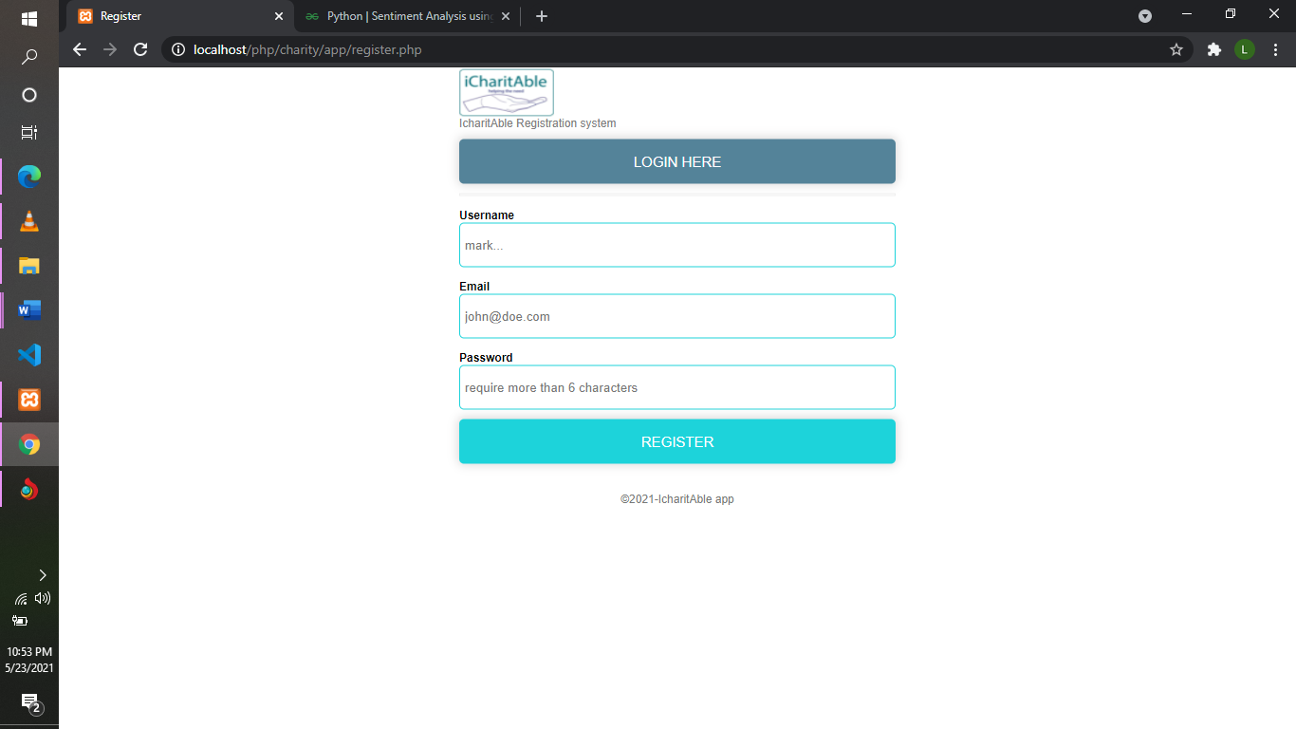
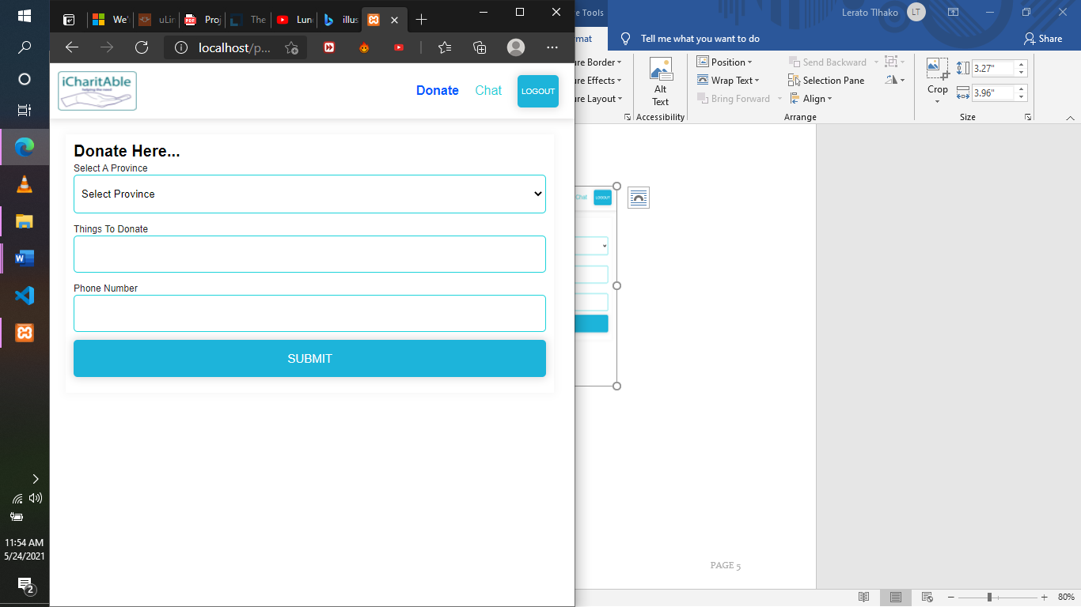
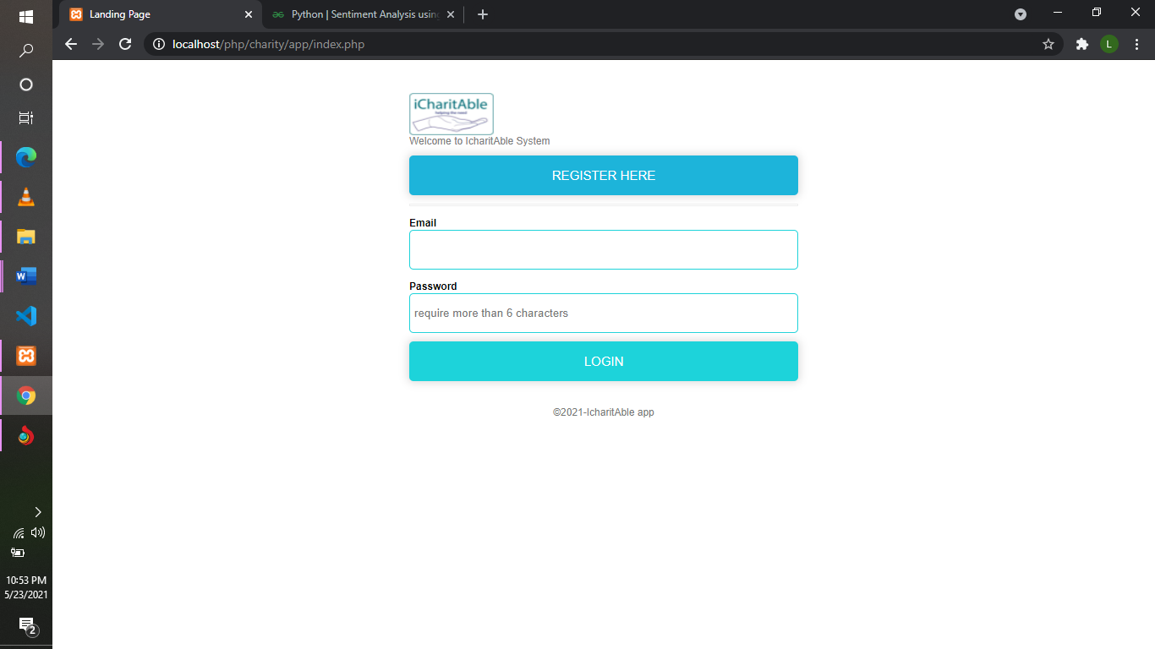
Solution Design/Architecture

Slide 8
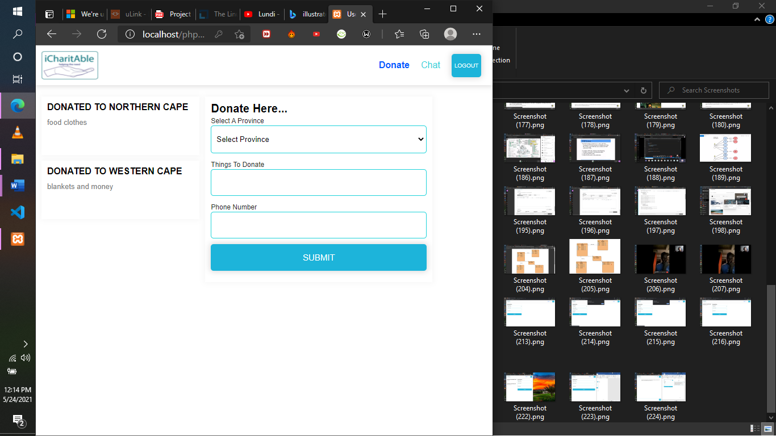
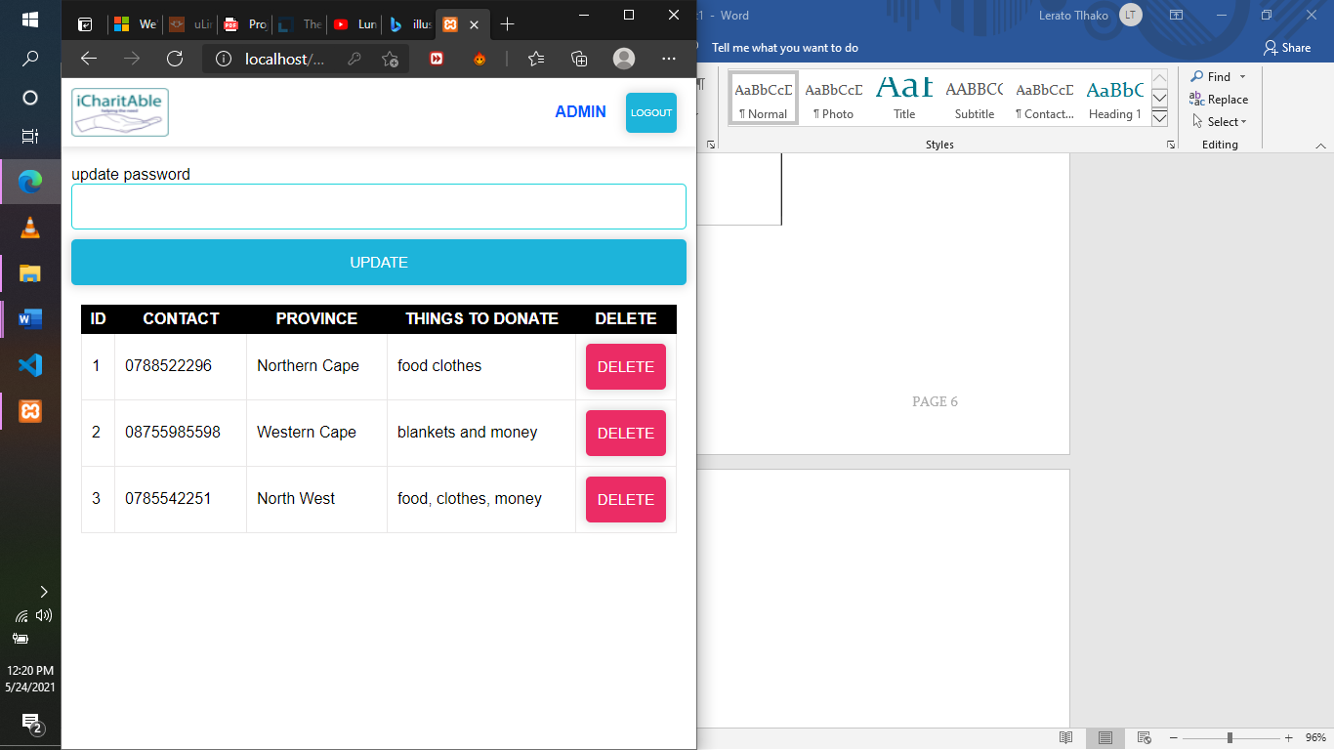
Solution Design/Architecture

Slide 9
Technologies Used
Technology used for the front end is :
PHP
HTML
CSS
Technology used for the backend:
JavaScript, jQuery
SQL
PHP

Slide 10
1
THANK YOU
ANY ?

Slide 11
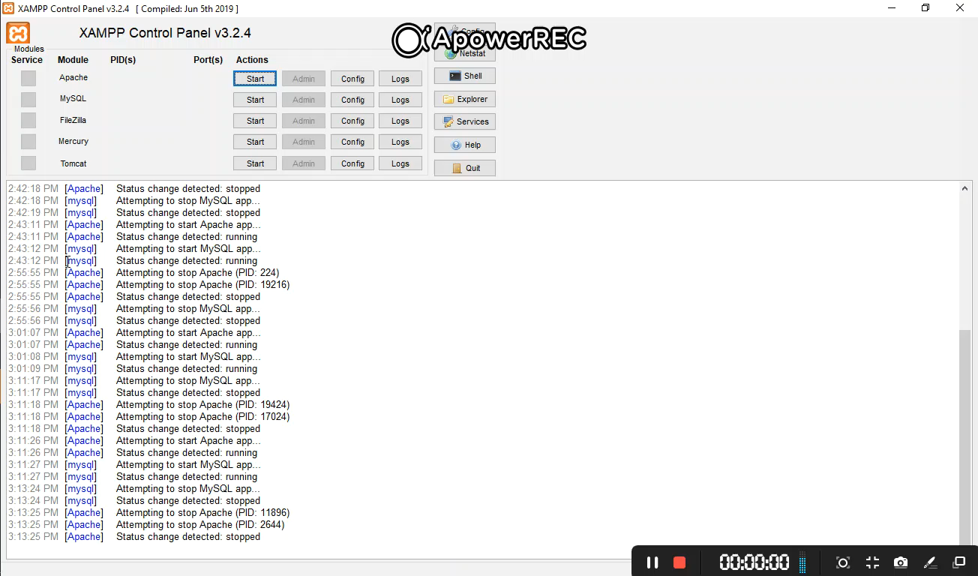
Live Project Demo

